Slide 1

Badminton Chatbot
By : Guru Ravi Shanker
Anubhav Sharma

Slide 2
Introduction
We have designed a chatbot , which specifically just like BASEBALL (chatbot on the game of Baseball , which used the matching against the templates from its database to answer the queries of the users) answers questions or queries related to badminton , but in a bit more interactive way and allows you to be flexible with your words .

Slide 3
Domain
Our bot can answer different sort of queries related to the game of badminton (including features of the game , its rules, some of its records and its history).

Slide 4
Constraints /Prerequisites
Queries should stick (other than certain salutations) to the theme.
Language : Hindi or code mixed (with Any language) but the keyword must be in Hindi.
Need to install the nltk package,re,bs for python.
**keyword-word containing the major information**

Slide 5
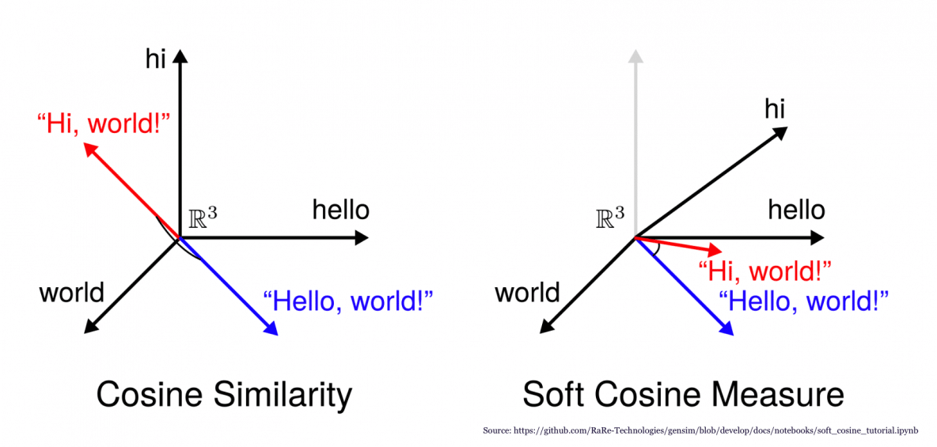
Algorithm/methodology used
There were various little methodology used at each and every single step but our major algorithm was the cosine similarity where we compute the measure of similarity between two non zero vectors of an inner product space that measure the cosine of the angle between them.Thus by matching the similarity between words of our dataset and the user’s query , we try to configure an optimal answer for each query.

Slide 6
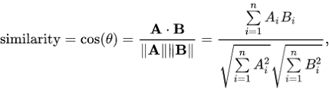
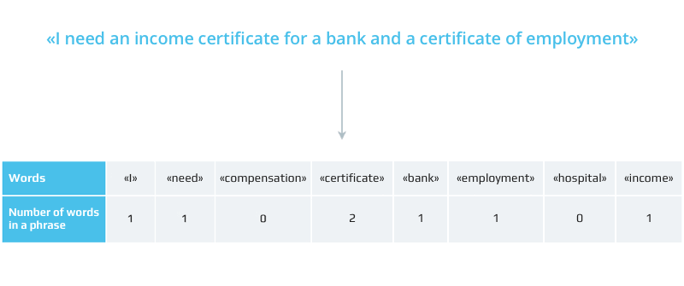
COSINE SIMILARITY
Stop words like मैं ,मुझको ,मेरा ,अपने , आप ,को हमने are not considered while computing similarities between two sentences .Since they occur on most sentences and comparing them will lead to wrong results if a sentence contains more occurences of stop words.
Our Algorithm computes cosine similarity with only key words for better performance.

Slide 7
Challenges (overcomed/facing)
Firstly getting a good data in hindi language was a challenge.(We extracted wikipedia page’s data about Badminton)
Then we had to get a good lemmatizer/stemmer in hindi so that we could get to the root of the word so that the inflections on the key word do not affect the result .
Then we had to make an interactive system which could reply even in adverse queries as the model was not looking at the semantics of the questions.
We had to make an interface for increasing its ease of usage.

Slide 8
Implementation
Here following are the steps that we have followed to accomplish our working:
Firstly we render data from web and remove the extra characters like hyperlinks and metadata using regular expressions.(For doing so we have a separate script which renders us the meaningful data) and store it in a file so that it can work without internet.
In our main script after a few manually inserted greetings we ask the user to enter his/her query .
Then we clean the query by removing extra spaces and then we remove the block words leaving us with just the keywords of the query.
Then we convert the particular query into a vector and measure its similarity with each possible vector of the database.

Slide 9
Implementation(cont.)
Then we return two statements with the highest similarities.
(before querying the keyword via the vector channel with we first stemmatize the keyword into its root and then further process it).
Stemming is done by checking if particular inflection is present or not if present return the word without the inflection.
We did not use a dictionary for lemmatized and normal sentences as we mentioned before..

Slide 10
RESULTS
1.Input ->प्रकाश पादुकोण कौन है
Output->बैडमिंटन खेल एक ऐसा खेल है जो हर उम्र के लोगों को अपनी ओर आकर्षित करता है।भारत में बैडमिंटन के कई महान् एकल खिलाड़ी हुए हैं, लेकिन भारतीय बैडमिंटन को सही मायने में दुनिया के सामने लाने का श्रेय जाता है- प्रकाश पादुकोण को, जिन्होंने 1981 के 'क्वालालांपुर विश्व कप फाइनल' में चीन के सुपरस्टार 'हान जियान' को 15-0 से हराकर चीनियों के सपनो को ध्वस्त कर दिया था
2.Input->शटलकॉक कितने किस्मों की होती है
Output->इसके अतिरिक्त, नायलॉन शटलकॉक तीन किस्मों के होते हैं, हरेक किस्म अलग तरह के तापमान के लिए होते हैं।ये नायलॉन शटल या तो प्राकृतिक कॉर्क या कृत्रिम फोम बेस और प्लास्टिक के घेरे से बनाये जाते हैं।

Slide 11
Errors
1.Enhance semantic priority i.e statement with more semantic value should be returned accordingly.(Example : Output on different queries).
Eg . In the previous query regarding prakash padukone the second half holds more semantic importance as compared to the first part .
2. Certain errors regarding absolute text matching when more that one occurrence is there in different contexts.
3. Anaphora resolution is not available.If input given has pronouns the output we get is not good .
4.Stemming not done properly for some words causing wrong matchings.

Slide 12
IMPROVEMENTS
1)Having a Lemmatizer will improve the accuracy.
2)Including more data to answer wide range of queries or a better way of Data Extraction.

Slide 13


